Slide 1
404 sleep not found
needfinding report
cmpsc 185
february 6, 2026
404 sleep not found

Slide 2




meet the team
mason le
jayden li
giovanni long
‘28
mill valley, ca
‘28
san jose, ca
‘26
thousand oaks, ca
404 sleep not found

Slide 3
01 value proposition
02 name selection
03 redefining our focus
04 problem + solution
05 market research
06 tasks
07 storyboard
08 video
agenda
404 sleep not found

Slide 4
404 sleep not found: the off-ramp for your brain
01: value proposition
404 sleep not found

Slide 5

02: name selection
we decided on 404 sleep not found as a reference to the HTTP 404 “Not found” error message
in web browsing, the error signifies a resource could not be found or is missing
our product, 404 sleep not found, seeks to be the resource to assist students that are “missing” sleep due to irregular schedules and work obligations
404 sleep not found

Slide 6

broadening our approach
03: redefining our focus
we broadened our solution to be more than just a mental “save point” (journaling to signal the end of the day)
we added some ideas from our solution 2: sensory prototype
triggering a wind-down state with quick, easy to follow guided actions
meditation, deep breathing, light exercise, etc
we also implemented ‘cues’ as another feature, prompting the user to wind down using pattern-based push notifications
404 sleep not found

Slide 7
04: problem + solution
primary users: students and late-night workers who have a hard time “switching off” due to academic and work commitments
the problem: people have a hard time falling asleep due to inconsistent and ineffective nightly routines
the solution: an app providing a cognitive save point through verbal journaling and time-based micro routines, allowing users to “disconnect” without the anxiety of forgetting
404 sleep not found

Slide 8
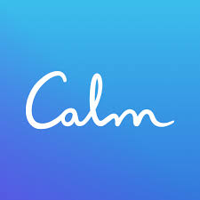
05: market research
what works
What works
what makes us different
strong "Sleep Story" library provides a narrative-based way to disengage from the day
"Daily Calm" feature - creates daily habit loop
mood check-ins
focus on active preparation (journaling, hygiene nudges) rather than passive listening.
a curated, decision-free flow avoids the "choice paralysis" of a massive library.
What does this segment want?
What motivates them?
What kind of products or services are they looking for?
Calm - Sleep, Meditate, Relax
mobile app designed to improve mental wellness, reduce stress, and aid sleep through guided meditation, mindfulness exercises, and soothing content
What doesn’t work
What interferes with their needs, goals, and motivations?
What frustrates them in their daily life?
what doesn’t work
overwhelming content library (thousands of titles)
high premium cost ($79.99/yr)
no active routines, only passive (listening)
takeaway
Calm helps users sleep; we help users get ready to sleep by owning the evening wind-down routine.
404 sleep not found

Slide 9
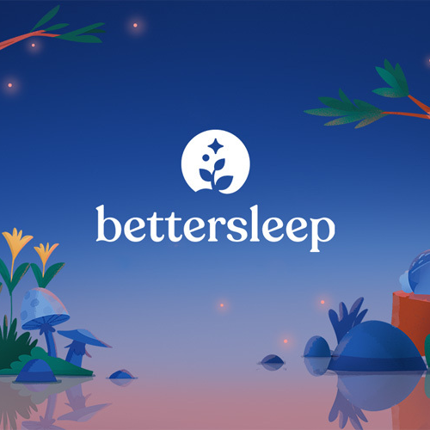
05: market research
what works
what makes us different
interactive and highly customizable sound mixer and experience
integrated sleep science and tracking
multitude of features, not just for sleep
active offloading by providing a “save state” to secure a user’s mental state
we normalize sleep schedule variation instead of daily pass/fail metrics
our product is an off-ramp to help settle down as well as plan for the next morning
BetterSleep
comprehensive wellness app designed to help users fall asleep faster and improve their sleep quality through a mix of audio therapy and data tracking
what doesn’t work
90% of features are paywalled
choice overload (300+ sounds) may cause “analysis paralysis”
focuses on drowning out thoughts rather than resolving the root cause
takeaway
bettersleep is moreso a passive distraction whereas 404 sleep not found provides an active resumption system
404 sleep not found

Slide 10

05: market research
what works
what makes us different
sleep debt is a good visualization for tracking what the user feels.
time nudges at good times (not just generic time)
brain dump feature
we aim to shift the focus away from quantitative measures and focus more on how the user feels
more suggestive rather than a hard number. (the brain is powerful and can trick the body)
Rise Science
app that helps improve sleep by focusing on sleep debt. Uses timed nudges and habits to help you with your schedule
what doesn’t work
sleep metrics can lead to guilt (bad metrics -> guilty)
users' feelings can depend on the number rather than the way they are actually feeling
takeaway
Rise manages the schedule; we manage the mindset. We should leverage their timed prompts but focus on qualitative relaxation instead of quantitative debt.
404 sleep not found

Slide 11



simple task
06: tasks
choose from a bank of relaxing activities
1:00
user quickly selects a low-effort activity to help wind down and prepare for bed, requiring minimal cognitive load and zero setup
404 sleep not found

Slide 12
moderate task
06: tasks
log a reflective "brain dump" entry
1:06
user records a guided journal entry to offload lingering stress and set intentions for tomorrow, helping to mentally disconnect from the day before trying to sleep
Complexity: Moderate because it requires active cognitive effort and introspection.
404 sleep not found

Slide 13
complex task
06: tasks
customize and follow a multi-step wind-down routine
1:12
user configures and adheres to a chained sequence of timed habits (e.g., shower, no screens, meditate) to fully automate the transition from awake to asleep
Complexity: High because it involves multi-step configuration and chaining multiple habits.
404 sleep not found

Slide 14
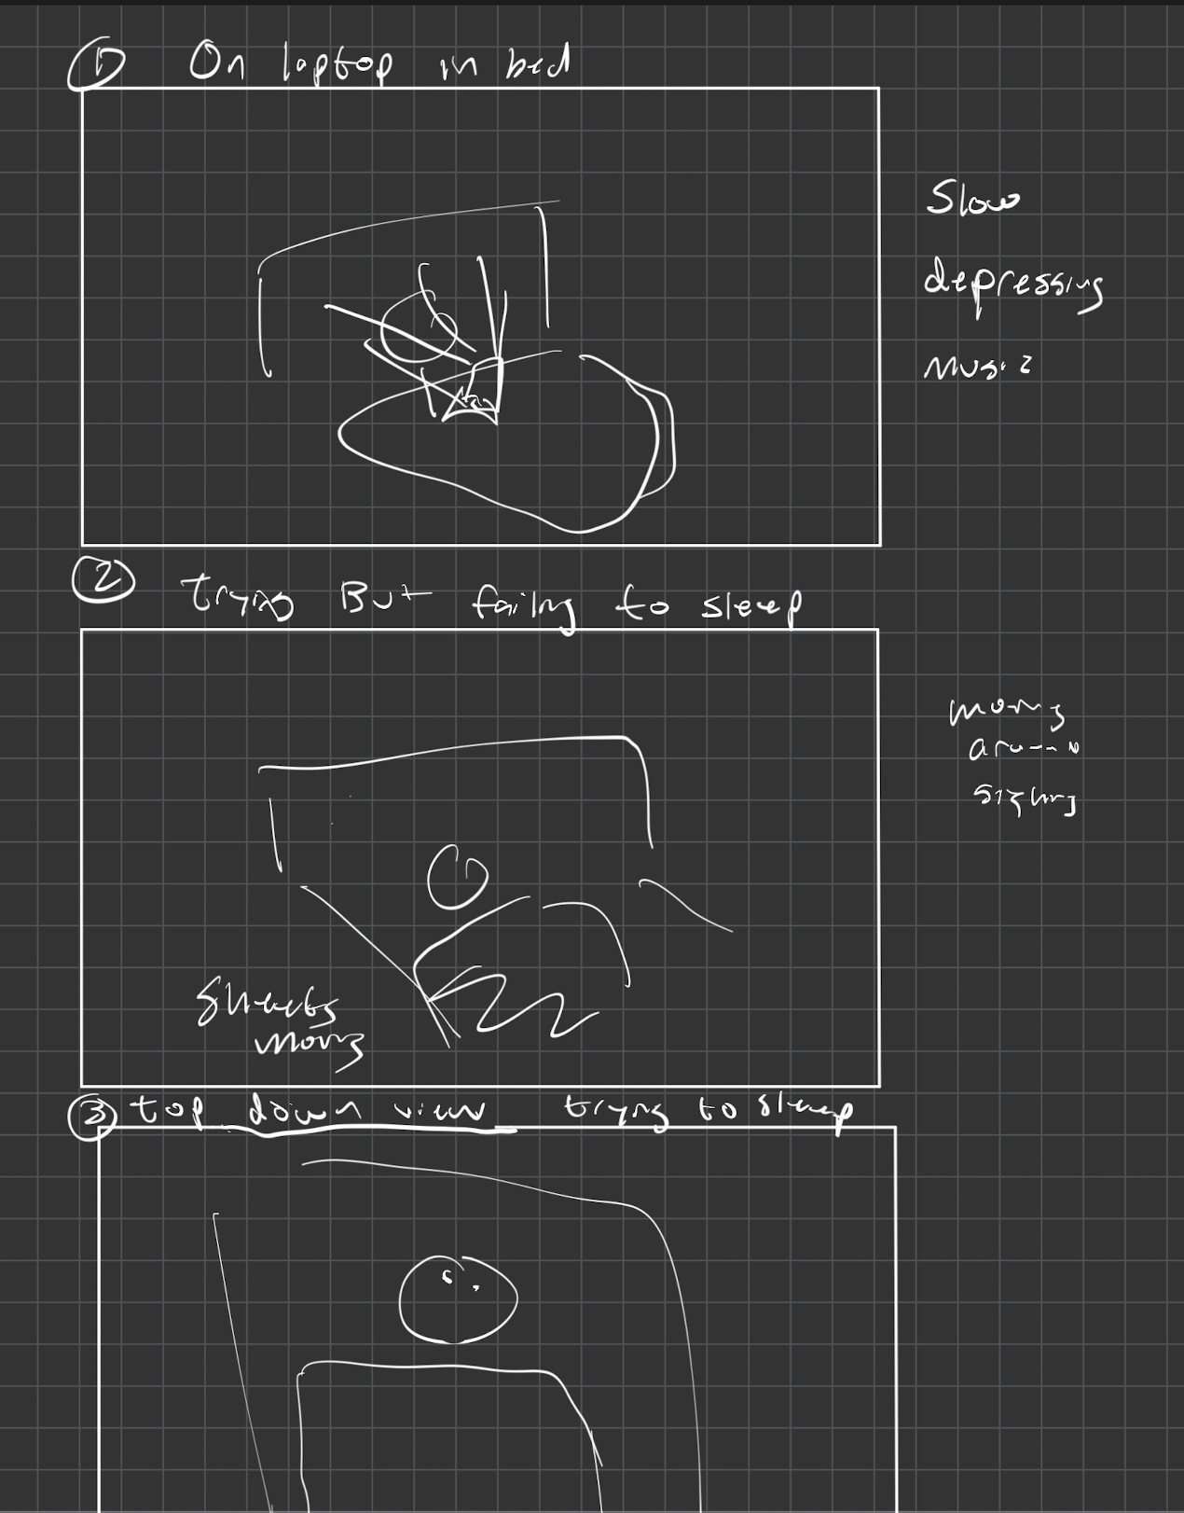
07: storyboard
Starts with laptop lighting up face
Struggling to fall asleep
404 sleep not found

Slide 15
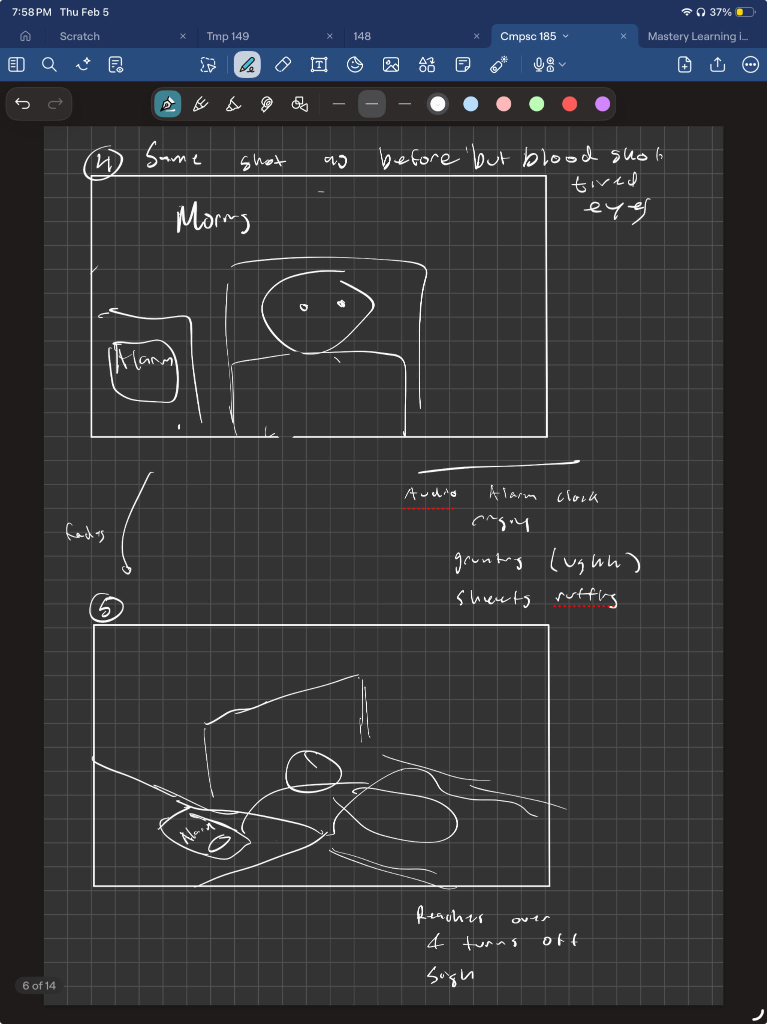
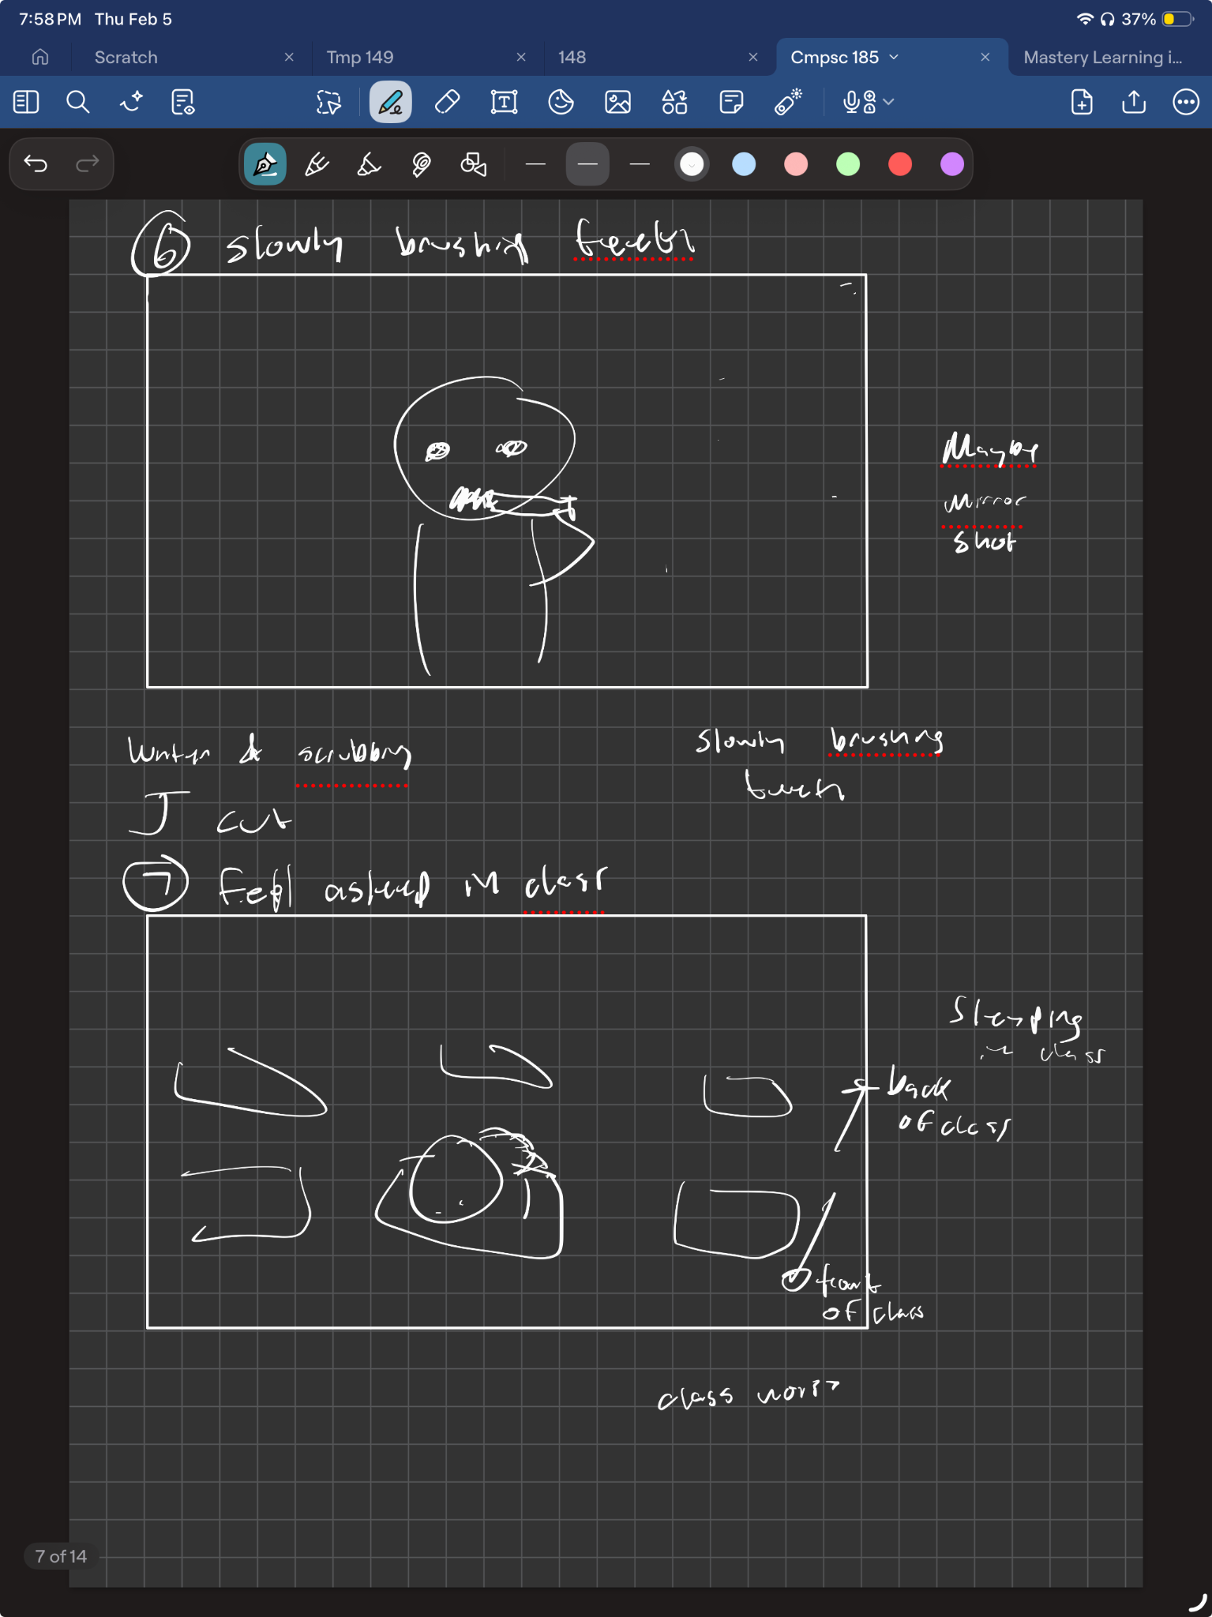
07: storyboard
User wakes up with bloodshot eyes
Sluggishly brushes teeth
Groggily turns off alarm with a sigh and rustling sheets.
falls asleep in the back of class.
404 sleep not found

Slide 16
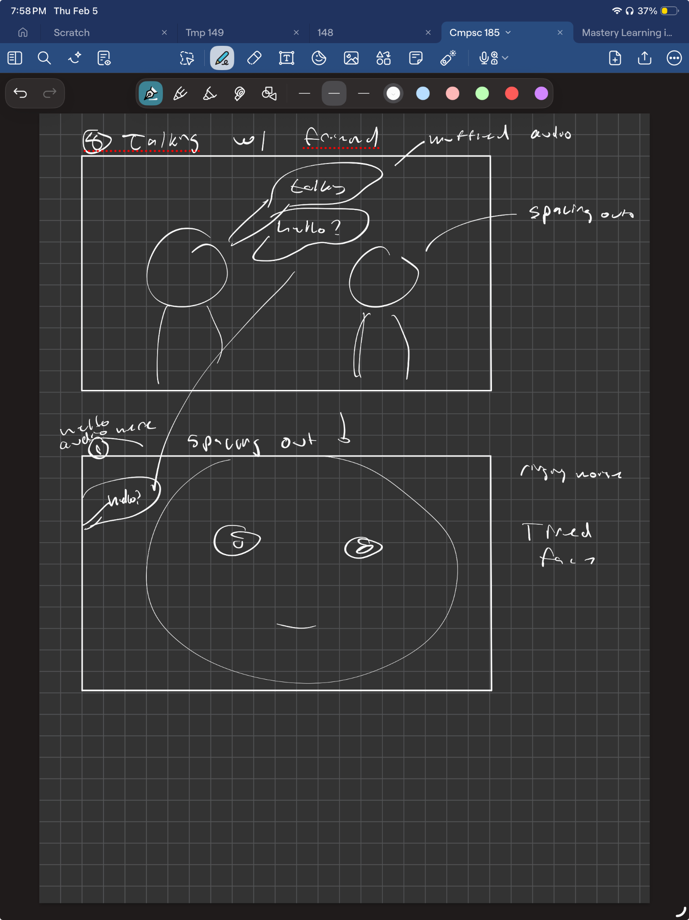
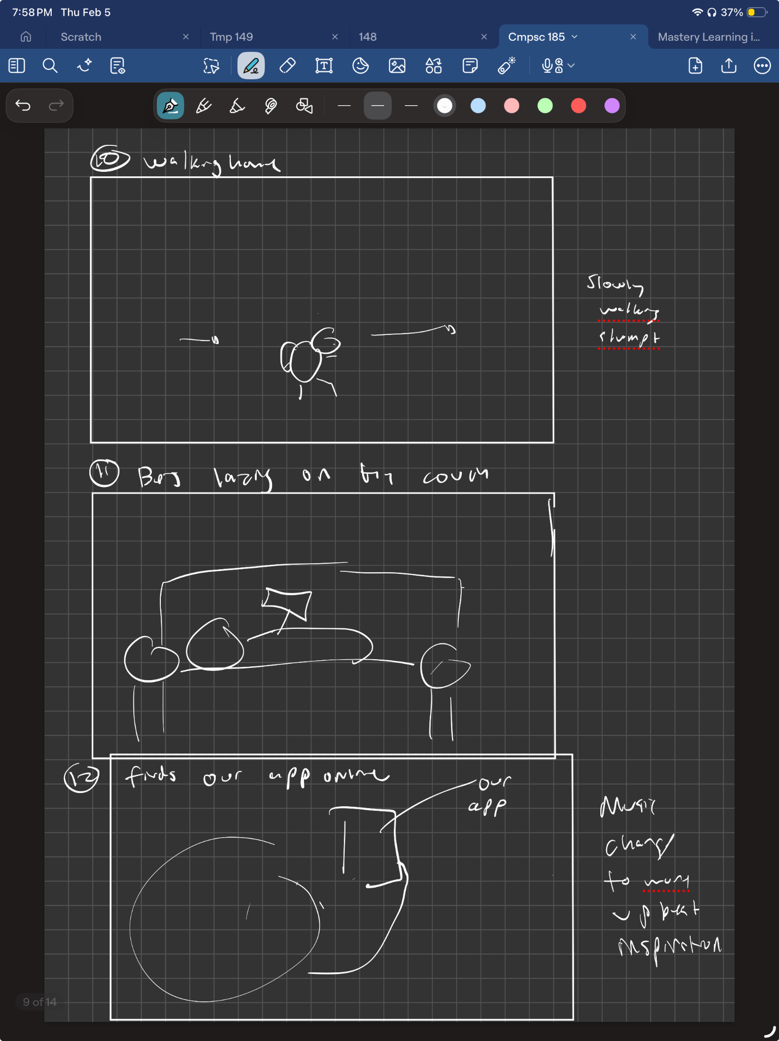
07: storyboard
Walking slowly home, slumped over
Zoning out/muffled hearing while talking to a friend.
Laying on the couch
Close up: tired face
Walks home feeling "stumped," finds our app online, and music shifts to upbeat.
404 sleep not found

Slide 17
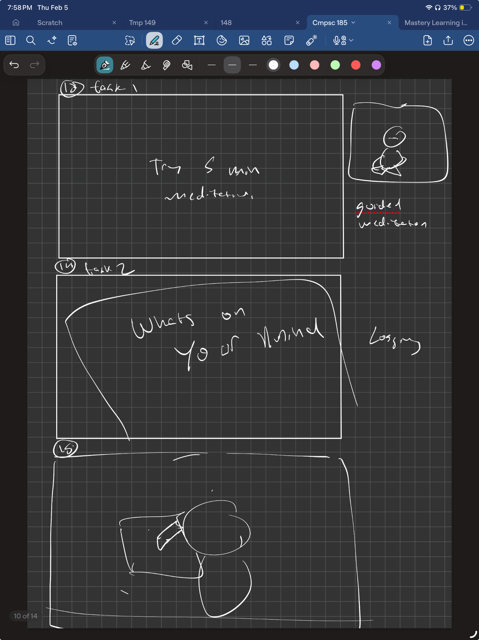
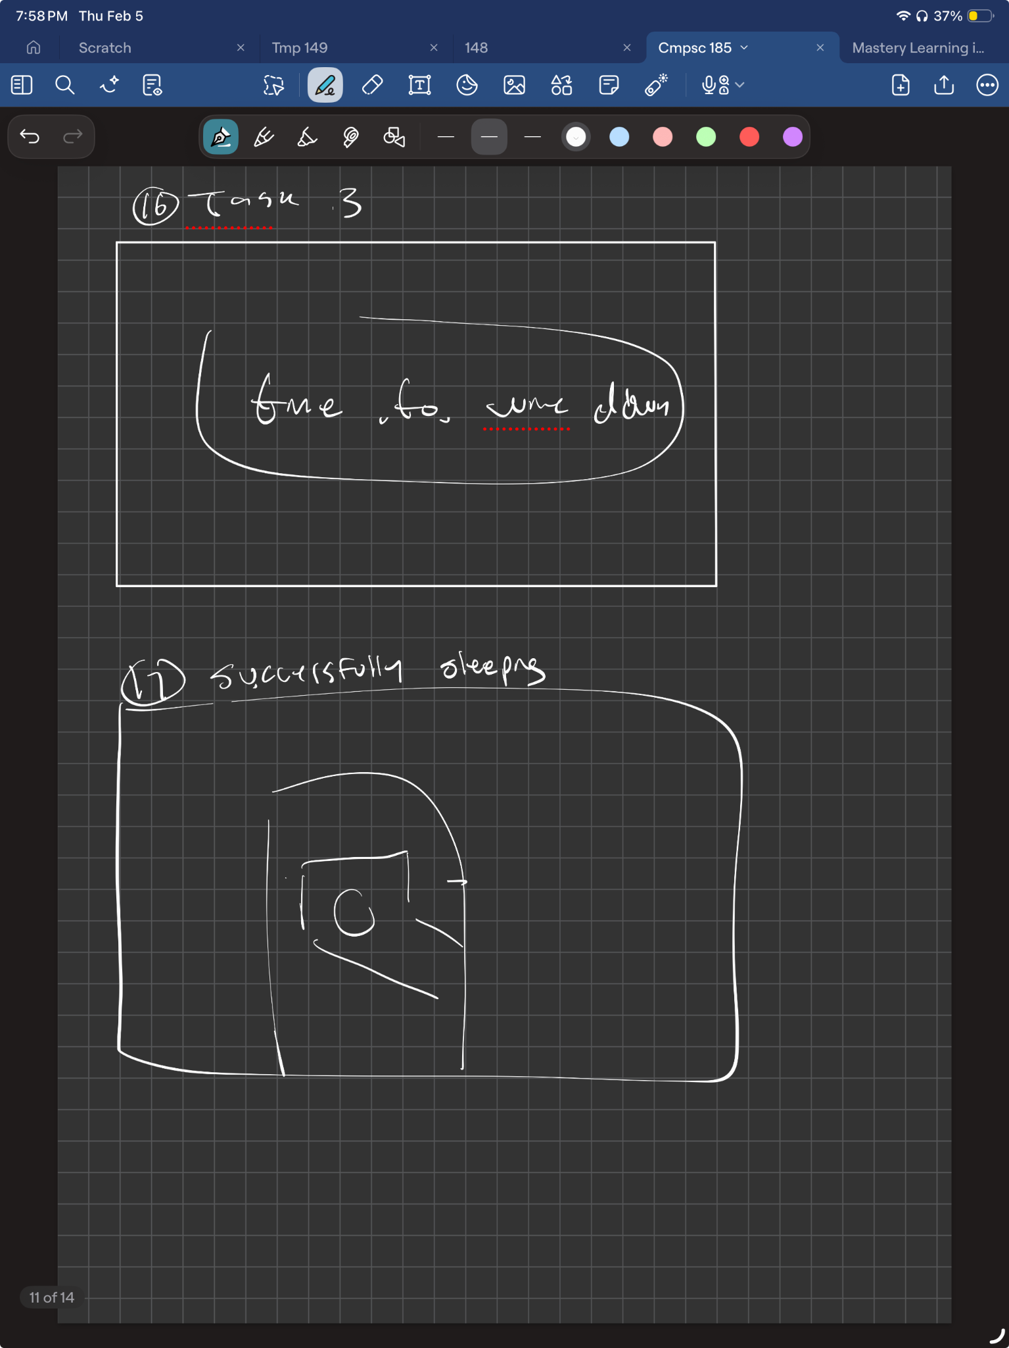
07: storyboard
Prompt from the app: “try 5 min meditation”
“time to wind down”
successfully goes to sleep after following the steps
Journals as prompted by the app, decompressing
404 sleep not found

Slide 18
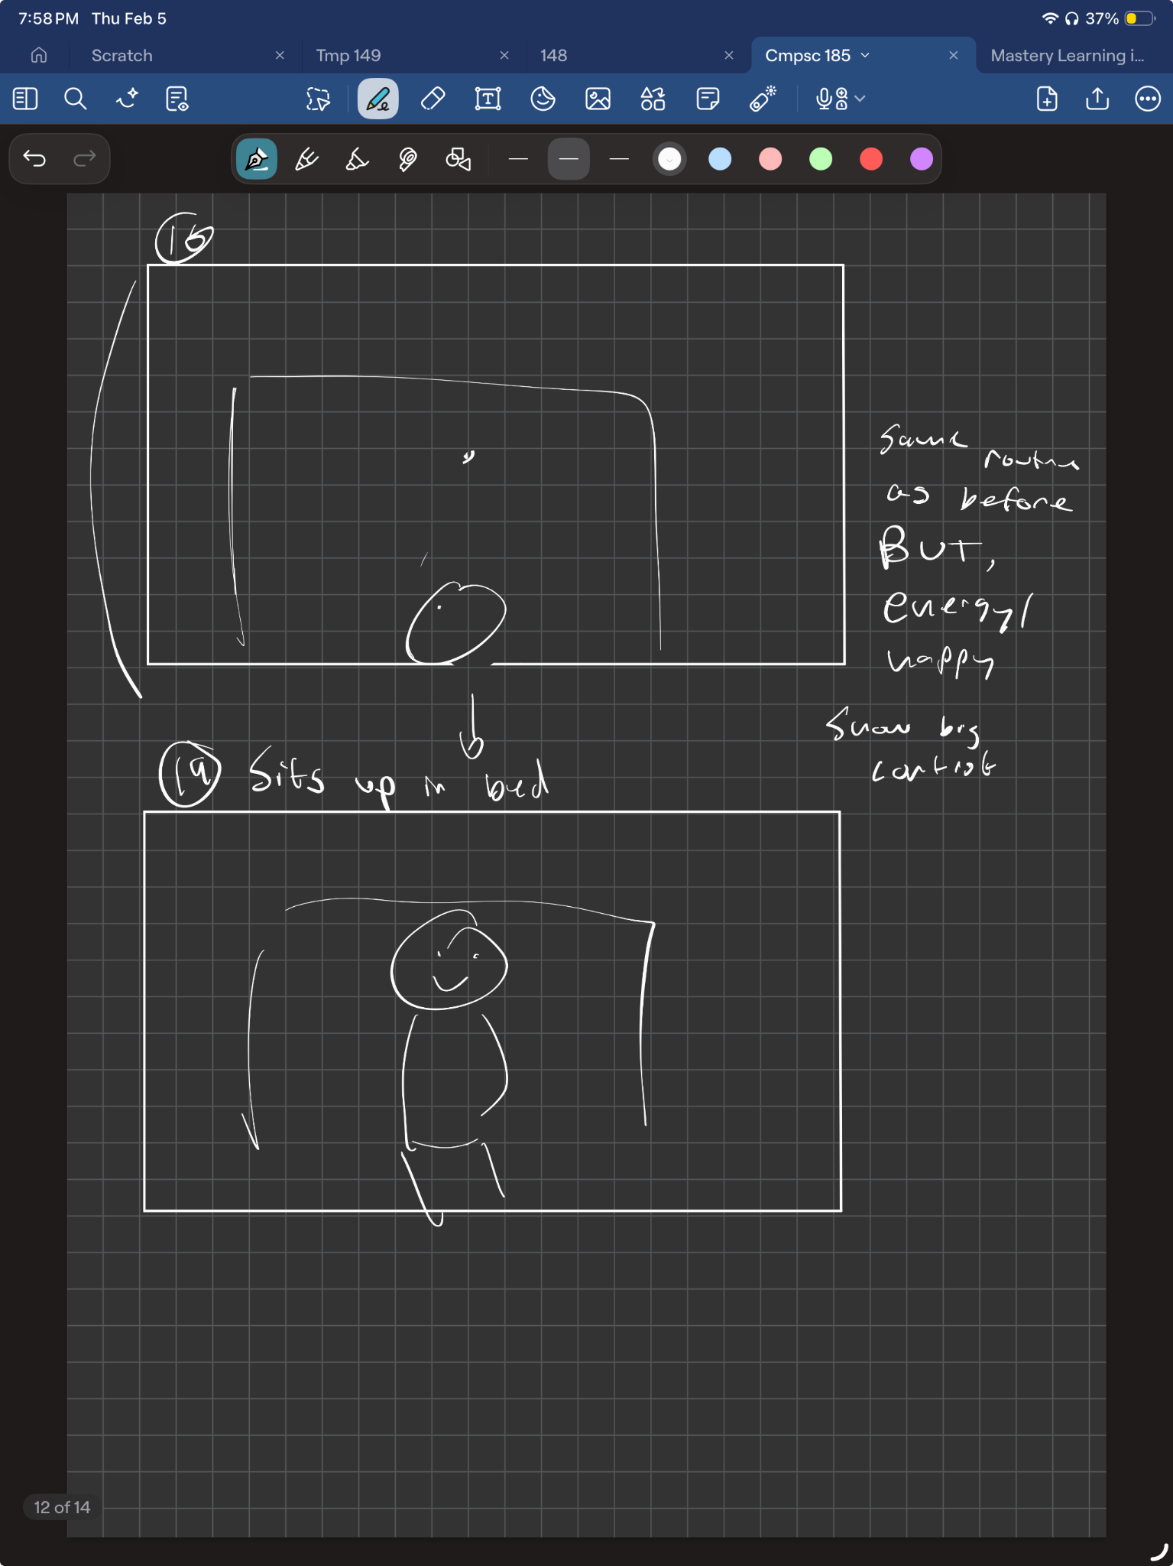
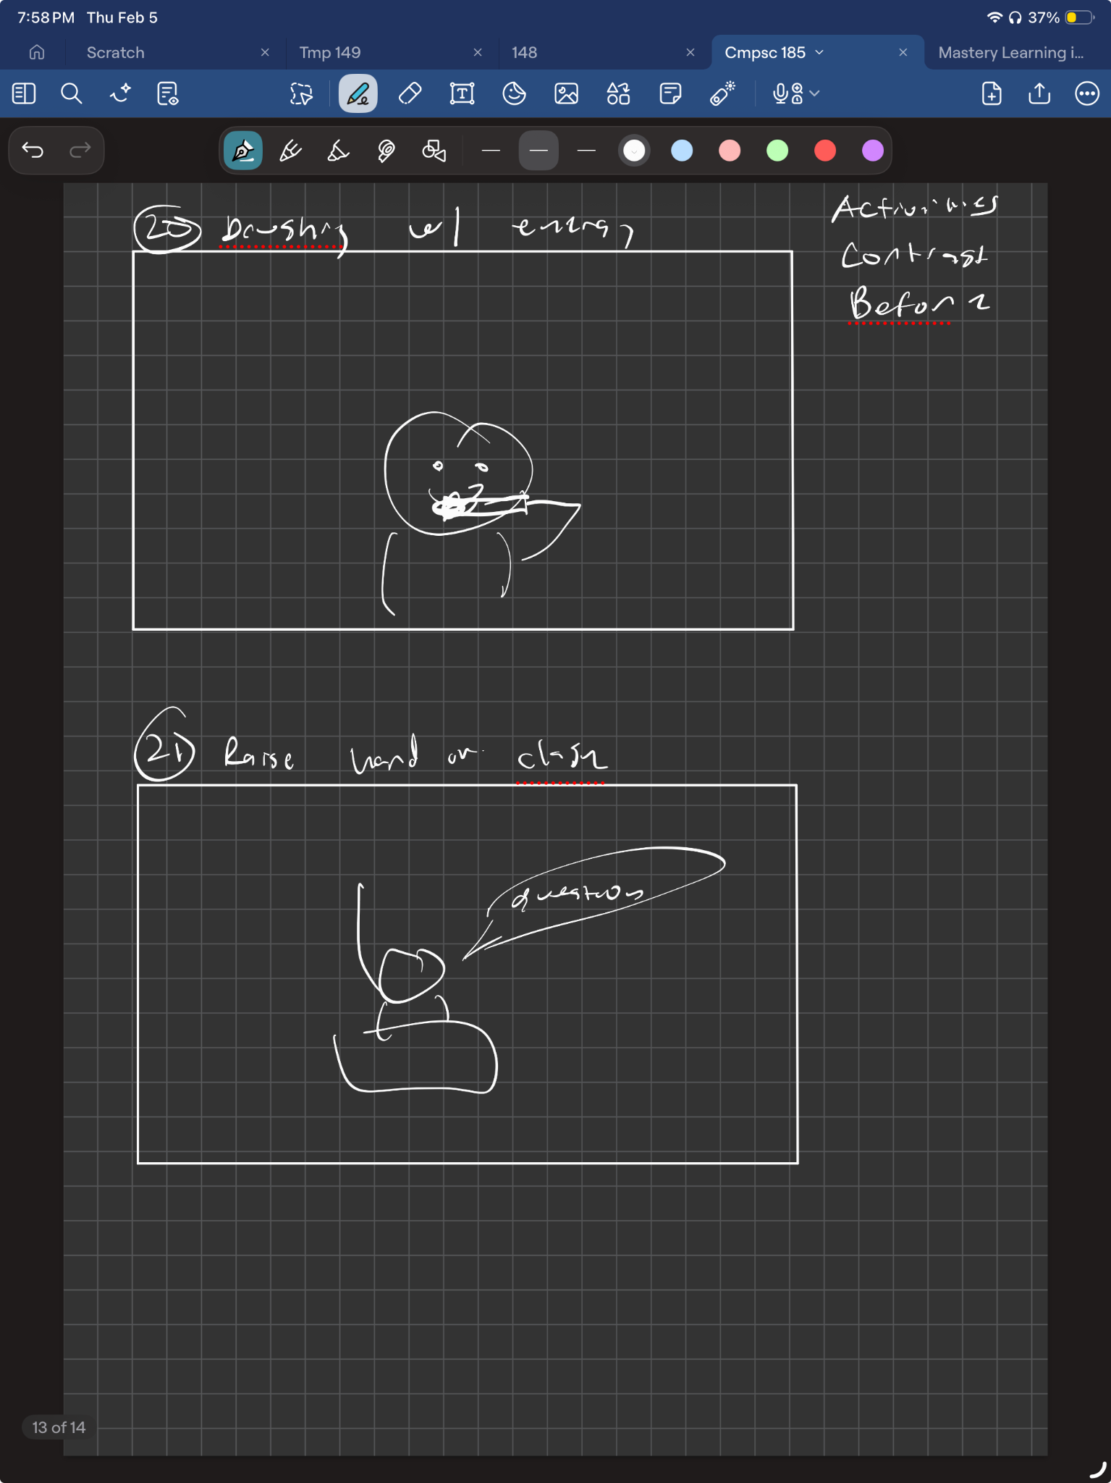
07: storyboard
Activities contrast before
Same routine as before, but energetic + happy
Engaged, raised hand in class
404 sleep not found

Slide 19
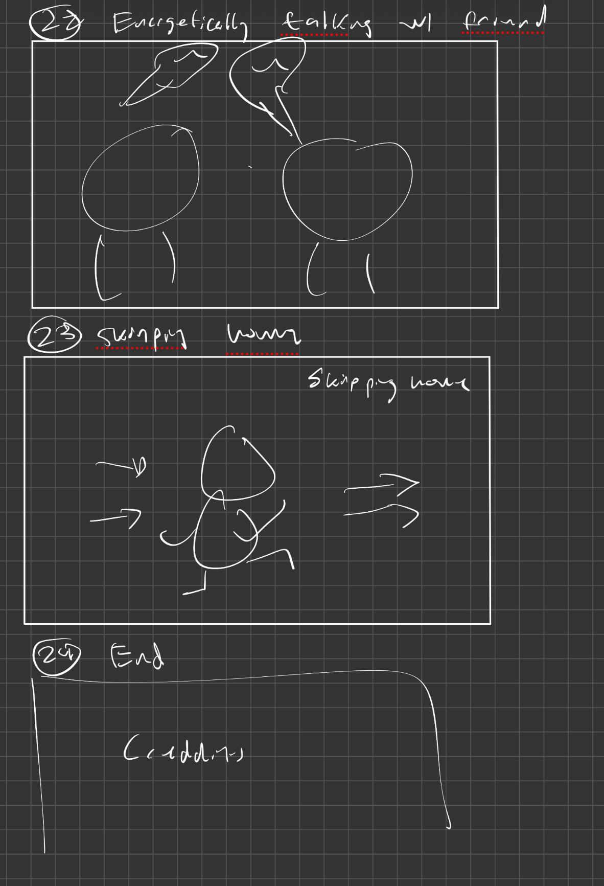
07: storyboard
Talking with a friend energetically
Skipping home
End credits
404 sleep not found

Slide 20


concept video
08: video
404 sleep not found

Slide 21
Thank you
404 sleep not found

